Slide 1
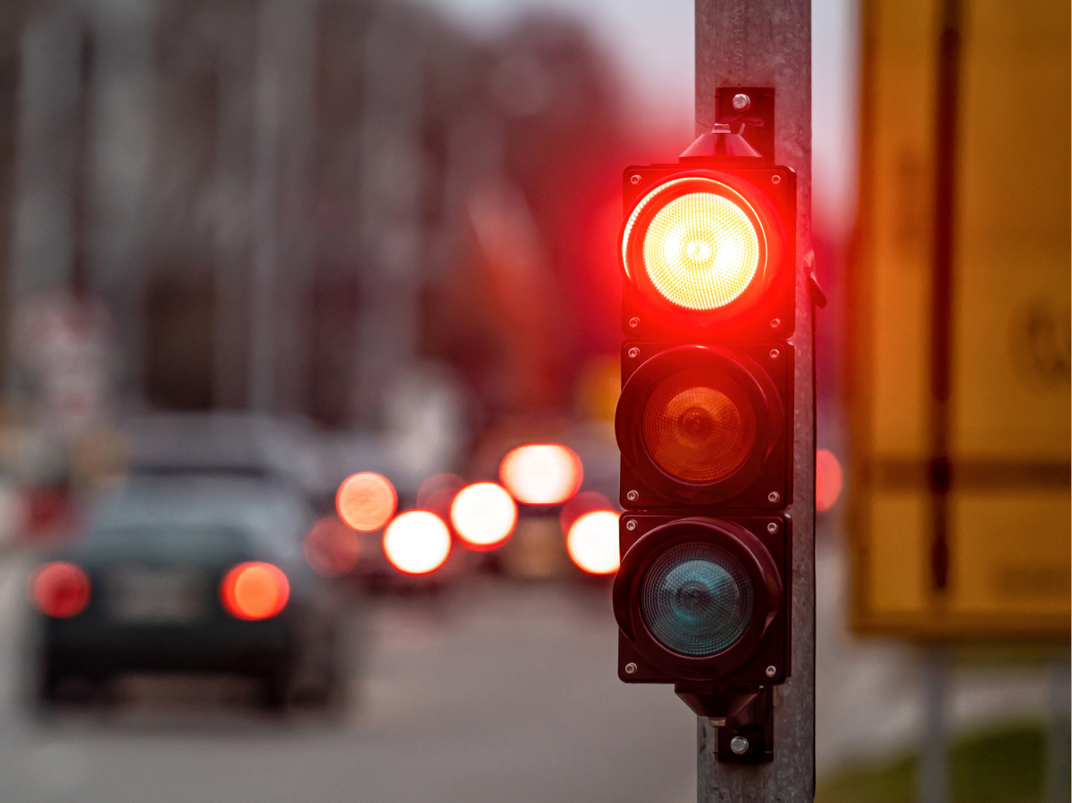
SecureCheck: A Python-SQL Digital Ledger for Police Post Logs
Submitted By,
Selva Saranya
DS-S-WD-T-B56

Slide 2
Self Introduction

Slide 3
Project Domain Introduction:
Police Data Analytics:
It is a rapidly growing field that leverages technology and data science
To improve law enforcement operations,public safety and transparency
By collecting storing and analysing data from police activities such as traffic stops,arrests, searches and violation
Agencies can give valuable insights into crime patterns, officer performance and community interaction.

Slide 4
Project Objective
To build a robust data pipeline and dashboard for police traffic stop records

Slide 5
Project Workflow
Clean and standardize raw police stop data for accurate analysis
Store the processed data in a postgresql database
Enable the advanced analytics and reporting
Support law enforcement agencies
Provide interactive visualizations and insights

Slide 7
SecureCheck: A Python-SQL Digital Ledger for Police Post Logs
Submitted By,
Selva Saranya
DS-S-WD-T-B56

Slide 8
Self Introduction

Slide 9
Project Domain Introduction:
Police Data Analytics:
It is a rapidly growing field that leverages technology and data science
To improve law enforcement operations,public safety and transparency
By collecting storing and analysing data from police activities such as traffic stops,arrests, searches and violation
Agencies can give valuable insights into crime patterns, officer performance and community interaction.

Slide 10
Project Objective
To build a robust data pipeline and dashboard for police traffic stop records

Slide 11
Project Workflow
Clean and standardize raw police stop data for accurate analysis
Store the processed data in a postgresql database
Enable the advanced analytics and reporting
Support law enforcement agencies
Provide interactive visualizations and insights

Slide 12
Platforms and Tools Used
VS code
Postgresql
Streamlite

Slide 13
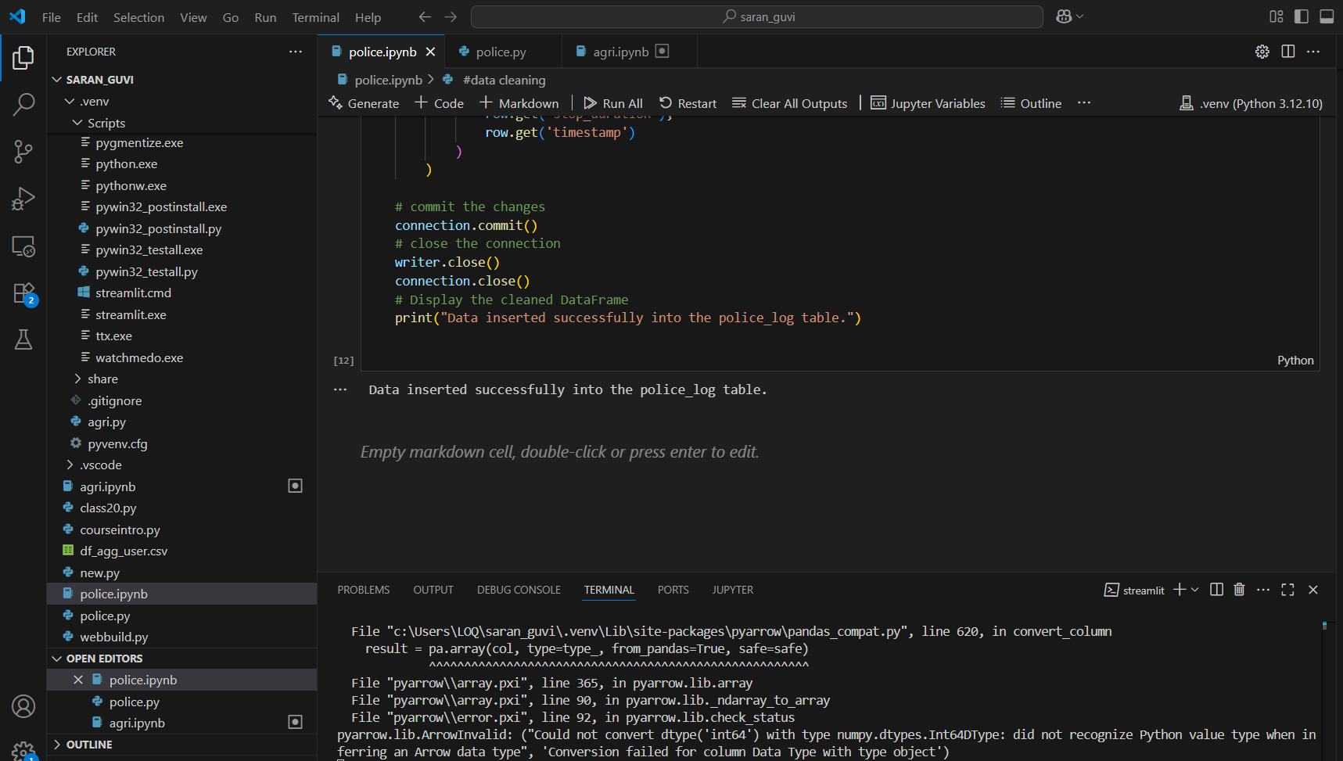
Data Inserted in Police log table Postgresql

Slide 14
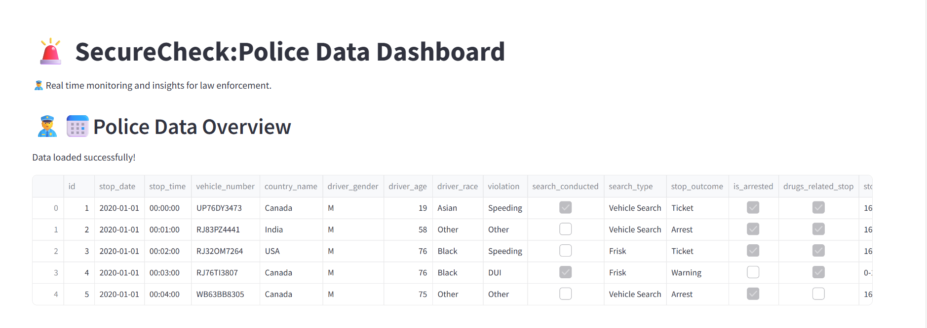
Streamlit Dashboard

Slide 15
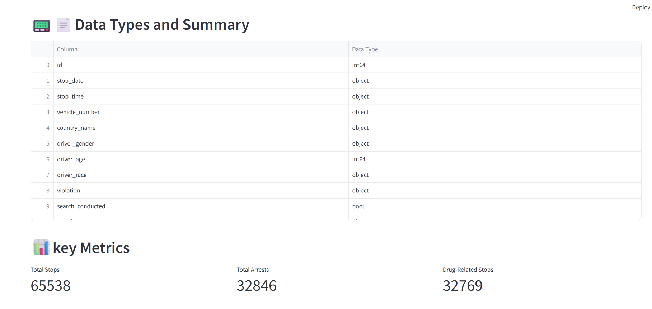

Slide 16
Thank You

